Slide 1
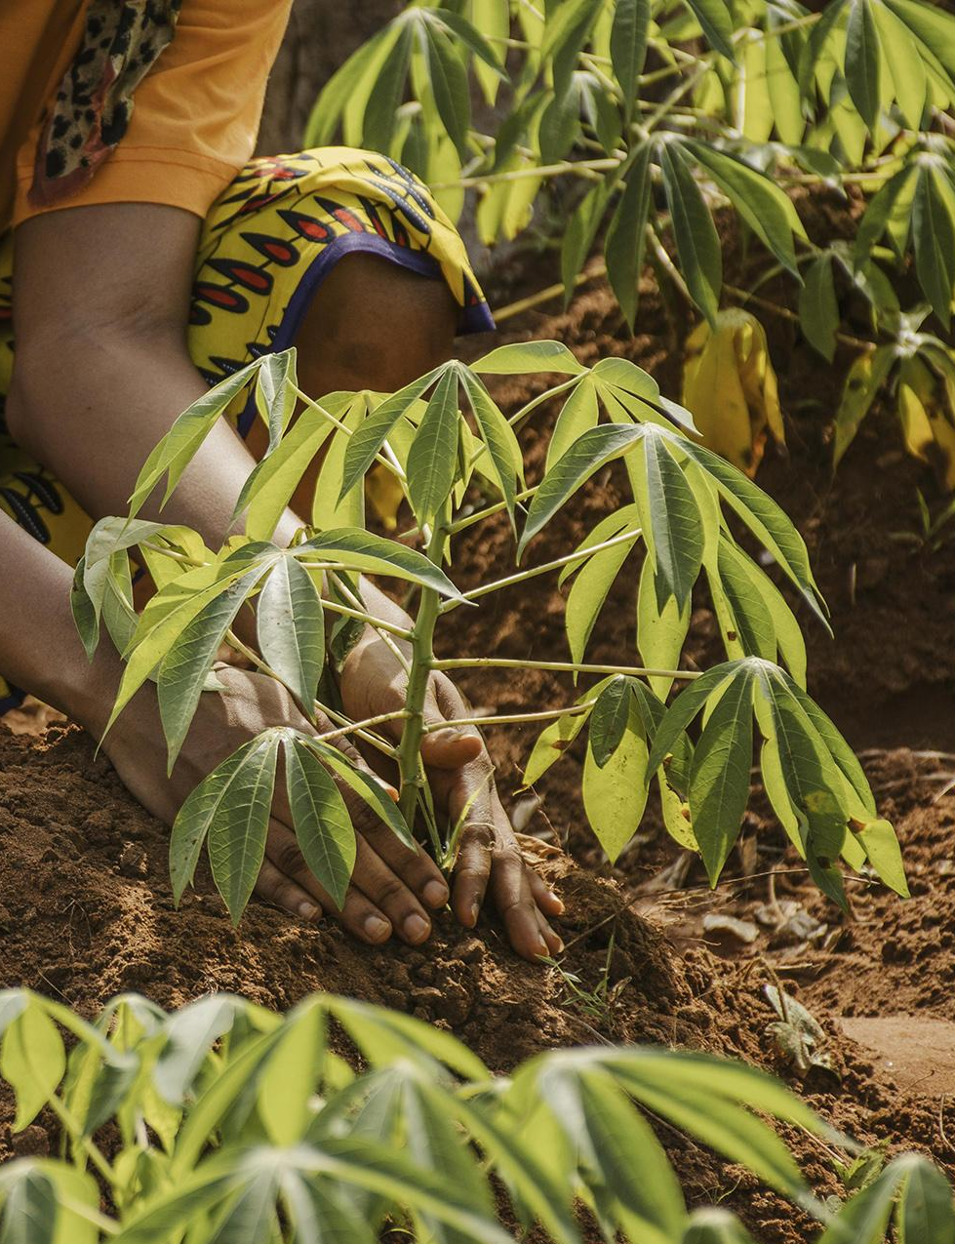
Matrix Farm Automation

Slide 2
Table of contents
01
02
03
Introduction
Need of Automation
Technology
04
05
06
Implementation Plan
Operating Plan
Conclusion
What is Farm Automation?
Why we need such Automation?
Technologies that will be used in this
How we can construct such System
How Farmers going to use our System

Slide 3
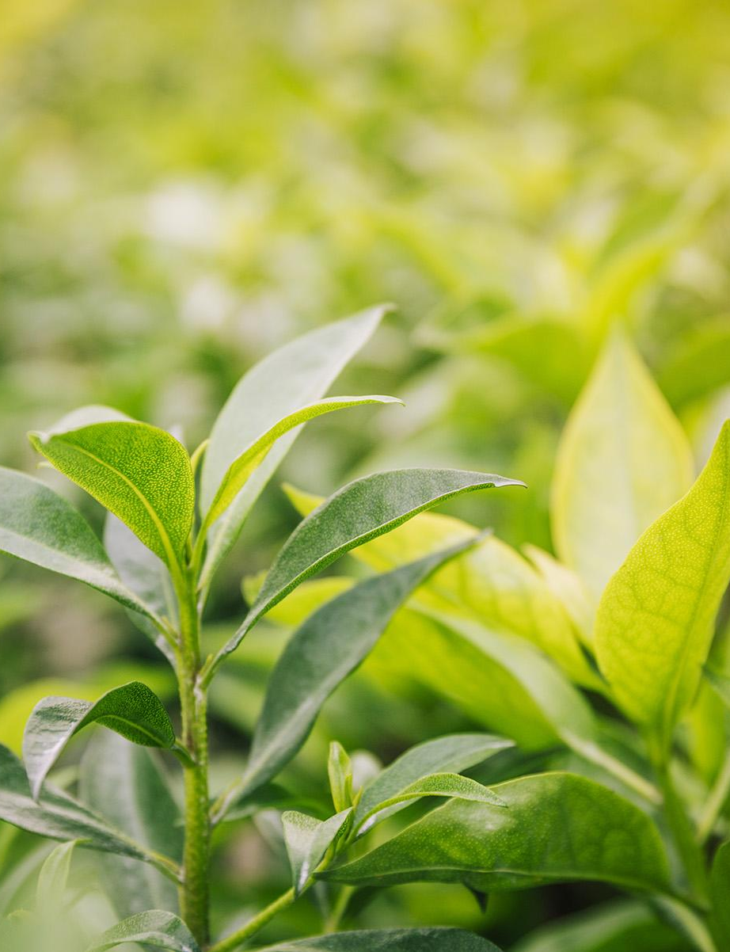
Revolutionizing Farming with Automation
This system automates irrigation, seeding, bird control and fertilizing of farms. It uses IoT devices and can be controlled via a mobile app. The app provides farmers with information about the farm, such as irrigation sensors, soil nutrients sensors, ultrasound systems for birds, and seeding robots.
The app also provides instructions to farmers for resolving problems. It helps to save time and resources, and also reduces labor costs. Farmers can easily monitor and control their farms with the help of this system.

Slide 4
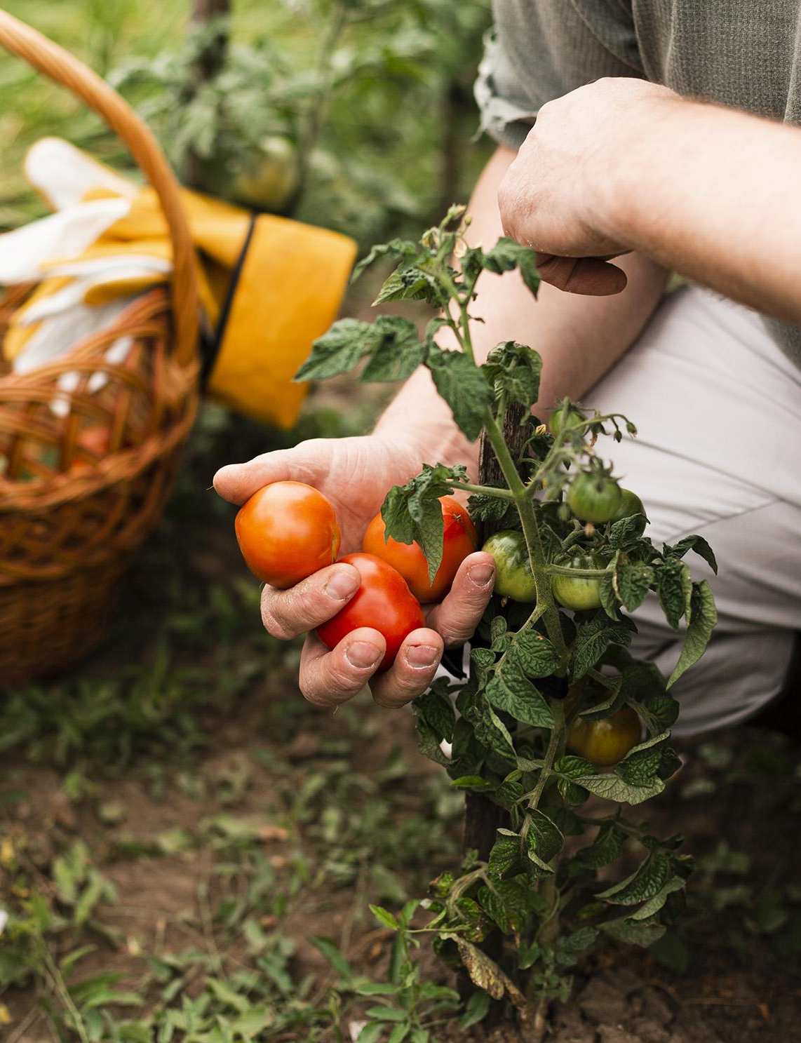
Need of the System
The Farming Automation System helps to save time and resources, and also reduces labor costs. Farmers can easily monitor and control their farms with the help of this system. The system also helps to reduce crop damage due to pests, weeds, and other environmental factors
.
The system also helps to increase crop yields and reduce the use of chemicals and fertilizers. The system is also cost-effective and easy to use, making it an ideal solution for farmers.

Slide 5
Technologies
IOT Devices
Mobile App
The Farming Automation System uses IoT devices to monitor and control the farms. These devices include sensors to measure soil nutrients, moisture, and temperature.
The mobile app allows farmers to monitor and control their farms remotely. The app provides information about the farm, such as irrigation sensors, soil nutrients sensors, ultrasound systems for birds, and seeding robots. The app also provides instructions to farmers for resolving problems.

Slide 6
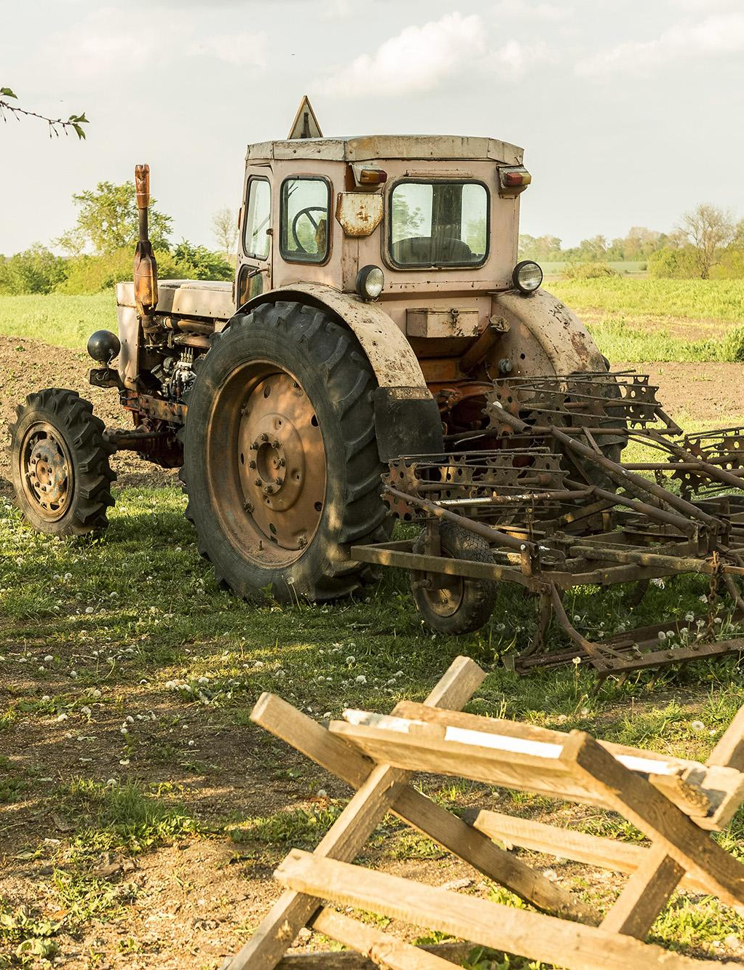
Implementation
Let's Automate ....

Slide 7
Implementation
01
02
03
Sensors / Controllers
IOT hub / device
Mobile App
Sensors study the soil and sends result to IOT hub which Directs controllers
Receive sensory inputs and signals to control by the order of mobile app
User can connect with the system using mobile app and can manage the system on its own or by automating

Slide 8
Operating plan
Maintenance
Data Collection
Regularly maintain the IoT devices and sensors to ensure that they are working properly. Check for any damages or malfunctions, and replace or repair them as needed.
Collect and analyze data from the sensors to determine soil nutrient levels, moisture, and temperature. Use this data to adjust irrigation, fertilization, and seeding to optimize crop growth.
Remote Monitoring
Training
Train farmers and farm workers on how to use the system, including the sensors, IoT devices, and mobile app. Provide ongoing training and support to ensure that everyone is comfortable with the system and can use it effectively.
Use the mobile app to remotely monitor and control the farm. Check the real-time data, alerts, and notifications provided by the app, and adjust the system as needed.
Troubleshooting
Provide troubleshooting support to farmers if they encounter any issues or problems with the system. Respond to inquiries in a timely and efficient manner to ensure that farmers can continue to use the system effectively.

Slide 9
Conclusion
The Farming Automation System is a cost-effective and easy-to-use solution for farmers. It helps to save time and resources, and also reduces labor costs. The system also helps to reduce crop damage due to pests, weeds, and other environmental factors.
The mobile app allows farmers to monitor and control their farms remotely. The app provides information about the farm, as well as instructions to farmers for resolving problems. The app is user-friendly and easy to use, making it an ideal solution for farmers.

Slide 10
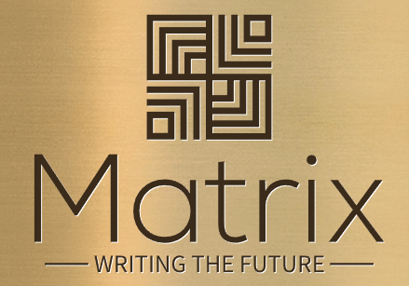
Thanks!

